Slide 1

West Nile Virus Prediction
DSI-16 Project 4
Alexis | Alyse | Dylan | Wei Tian

Slide 2

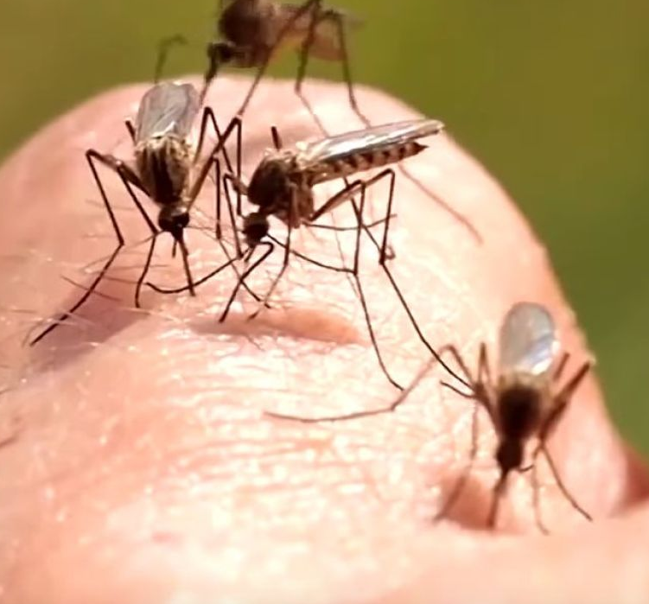
Business Problem
What are we trying to solve?
Who are we?
West Nile Virus
Our Mission
To create a predictive model for us to identify the presence of WNV at different locations, time of year and other factors in Windy City.
Identify problem areas in Windy City ahead of time
Suggest suitable remedies to prevent the spread of West Nile Virus in the region
Key Project
Goals
Data Science Team within the Disease and Treatment Agency
Focus area: Chicago
West Nile Virus (WNV) has been prevalent in Windy City, Chicago, over the last few years.

Slide 3
Part I
Data Cleaning

Slide 4
Train / Test Dataset
Overview and Processing
Train Dataset
Test Dataset
12 columns, 10,506 entries
Samples taken in odd years: 2007, 2009, 2011, 2013
Includes date, trap, address, species collected, number of mosquitos and presence of WNV
Unique samples are split into ‘bins’ of 50
11 columns, 116,293 entries
Samples taken in even years: 2008, 2010, 2012, 2014
Same columns as train data except for NumMosquitos and WnvPresent
Samples are also split in the same way
Processing
Streamlining variables:
Clustering traps by latitude and longitude and assigning each trap a cluster ID, dropping other address columns
Feature engineering:
Dates: Day of year, month, week of year etc.
MultipleBins: Track whether the row is part of a larger sample
One-hot encoding: For most infectious species and clusters

Slide 5
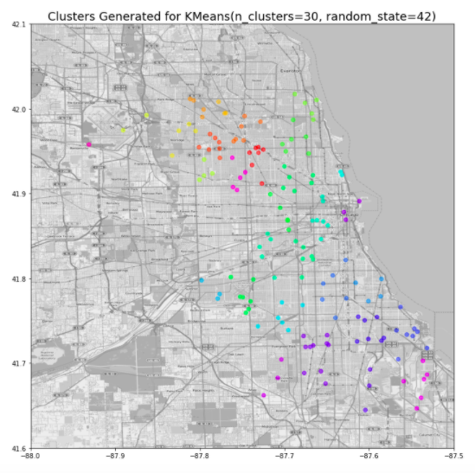
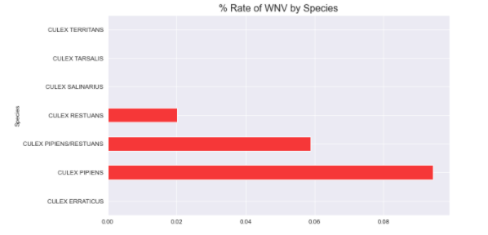
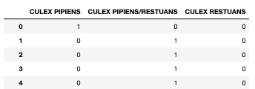
Train / Test Dataset
Feature Engineering
One-hot encoding of species
Clustering traps by latitude and longitude

Slide 6
Weather Dataset
Overview and Processing
Weather Data from NOAA
Data Processing
Data cleaning: Imputation of null values by monthly averages,
Feature engineering:
Relative humidity based on dewpoint and avgtemp
Daylight hours based on sunrise and sunset times
22 columns, 2,944 entries
Daily weather metrics from 2 weather stations in May to October from 2007 to 2014
Includes date, station, temperature, sunrise and sunset time, weather conditions

Slide 7
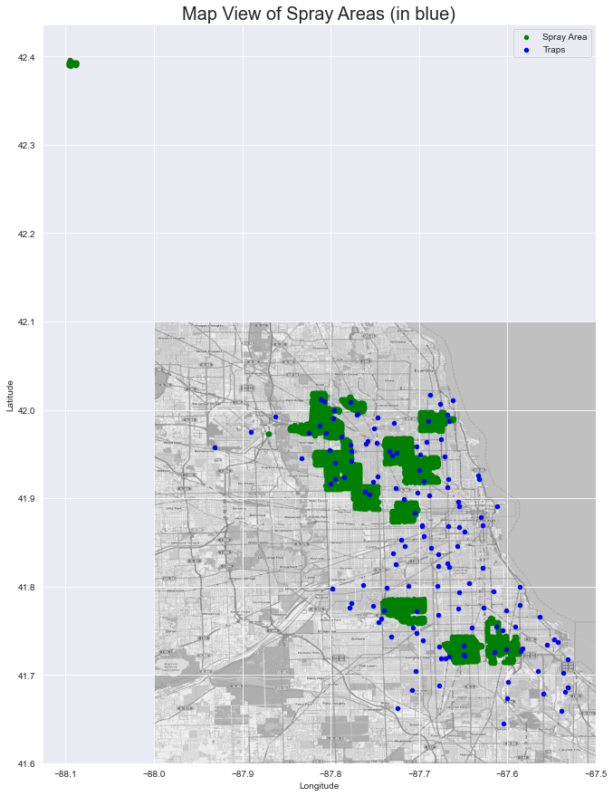
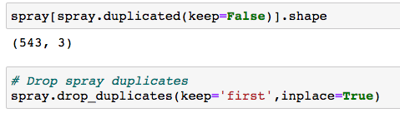
Spray Dataset
Minor cleaning for the Spray dataset
Dropped Duplicates for Spray Data
Removed anomaly data point in Spray Data

Slide 8
Part II
Exploration of Data

Slide 9
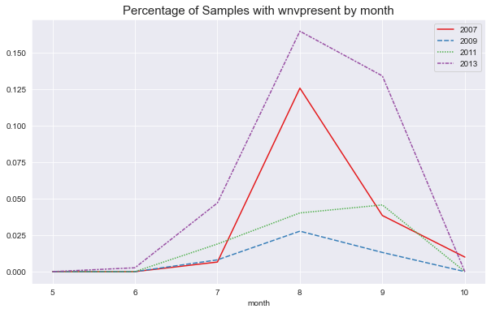
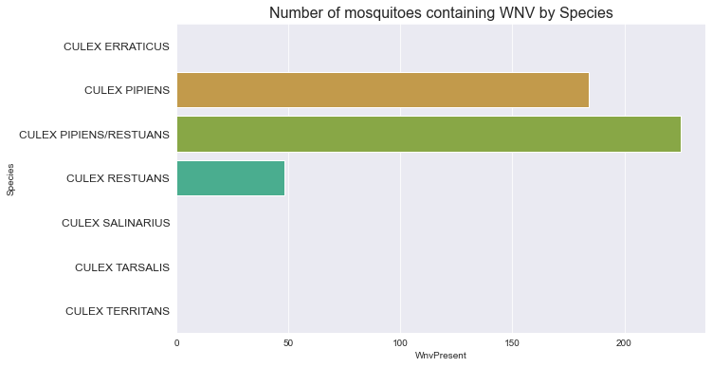
Collected Mosquito Data: Key Findings
Analysis of WNV presence
Monthly WNV Analysis amongst samples
Mosquitoes Species Analysis
From the chart above, we observe the presence of WNV amongst mosquitos spike in August and subsides thereafter.
Amongst the 6 unique species of mosquitoes present in Windy City, only 2 species carry the WNV.

Slide 10
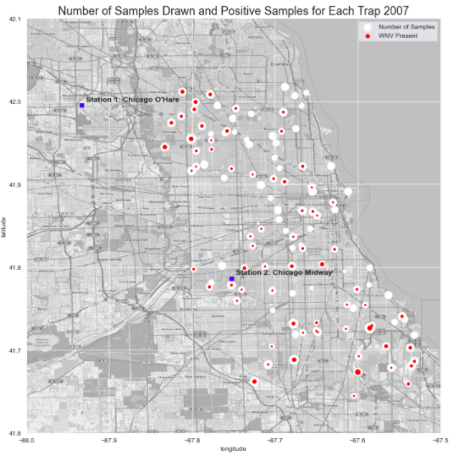
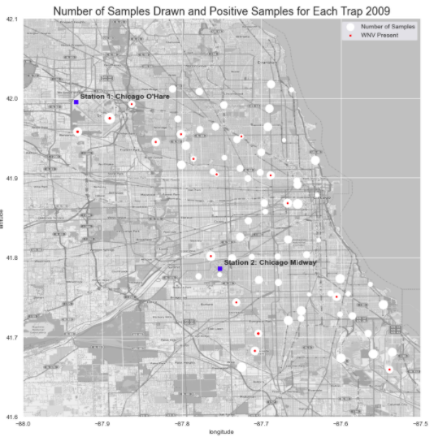
Collected Mosquito Data: Key Findings
Analysis of WNV presence

Slide 11
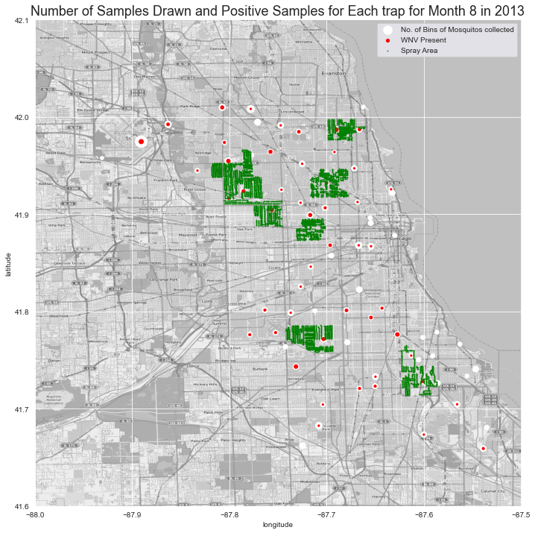
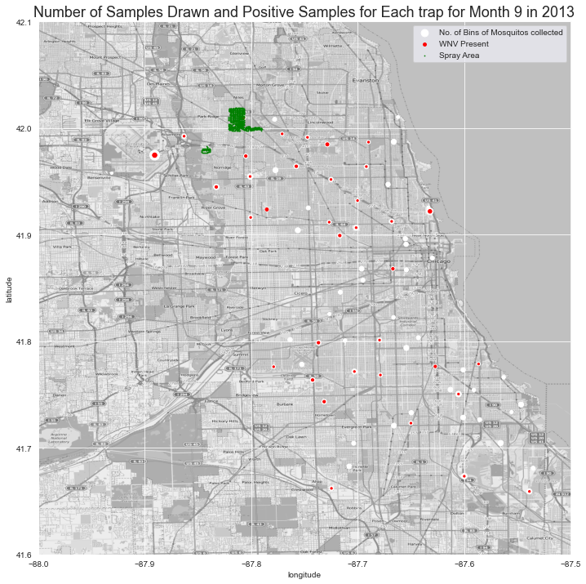
Collected Mosquito Data: Key Findings
Spray Effectiveness: Reduction in Number of Mosquitos & Presence of WNV

Slide 12
Collected Mosquito Data: Key Findings
Spray Effectiveness: Reduction in Number of Mosquitos & Presence of WNV (Zooming in!)
ONE MONTH
LATER
Sprayed areas (in green) in Aug 2013
Mosquito count & WNV presence in Sep 2013
Results:
Less ‘bins’ of mosquitoes collected
Less samples with WNV presence
Have to take into account rates of infection in each month

Slide 13
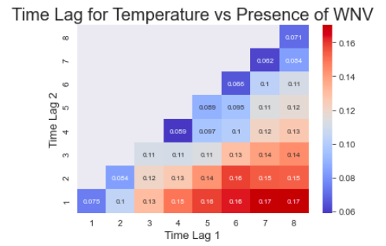
Weather Cross-correlation w/ WNV Presence
Which weather features are the most predictive?
Cross-correlation maps (CCMs) depict Spearman rank-order correlations (Spearman rank order correlation coefficients) between various weather factors and the presence of the WNV virus.
Time Lag 1: Start week for averaged data
Time Lag 2: End week
for averaged data
This graph illustrates that the temperature averaged across the past eight weeks has the highest correlation to the WNV presence.

Slide 14
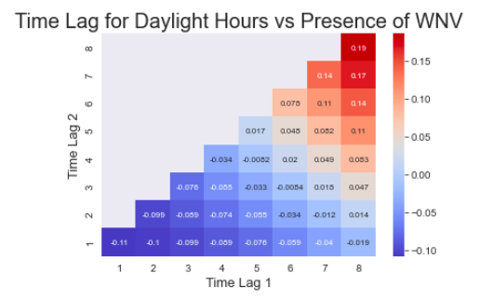
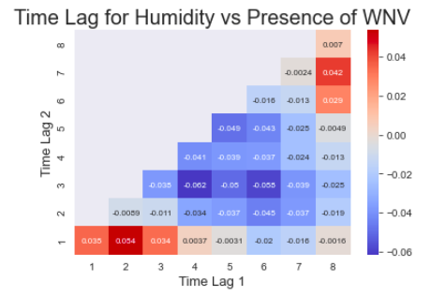
Weather Cross-correlation w/ WNV Presence
What features did we shortlist?
Daylight Hours: avglight_week8_8, avglight_week1_1
Humidity: avghumid_week7_8,
avghumid_week1_2, avghumid_week3_6

Slide 15
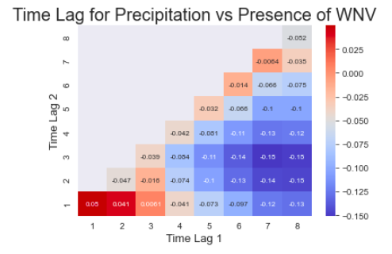
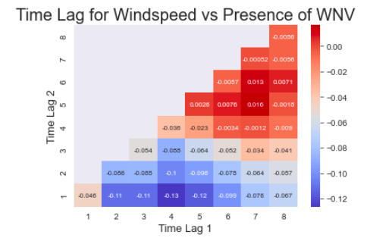
Weather Cross-correlation w/ WNV Presence
What features did we shortlist?
Precipitation: avgrain_week1_1, avgrain_week3_7
Humidity: avgwind_week5_7, avgwind_week1_4

Slide 16
Part III
Data Modelling

Slide 17
Data modelling
What is the baseline model?
The no recurrence model would validate on the train data with a 95% accuracy rate. Is this constructive?
Given that the aim is to predict where the west nile virus might occur, in this situation, we are looking for a model that picks out as many positive predictions as possible.
Sensitivity (SN) is calculated as the number of correct positive predictions divided by the total number of positives. It is also called recall (REC) or true positive rate (TPR).
The best metric to maximise might then be the recall, or sensitivity rate.
The models used were logistic regression, K nearest neighbours, decision tree, bagging classifier, random forest classifier, adaboost classifier, SVC, extratrees and XGboost

Slide 18
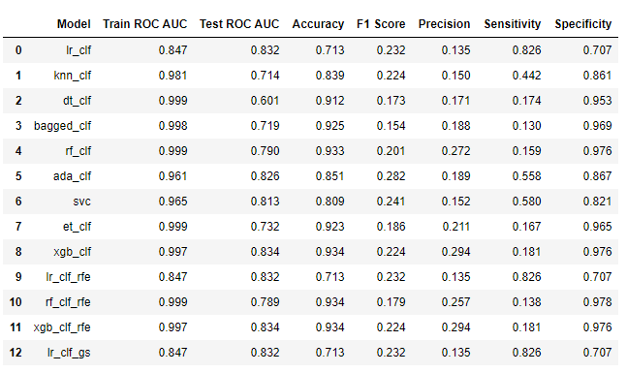
Which is the best performing model?

Slide 19
Which is the best performing model?

Slide 20
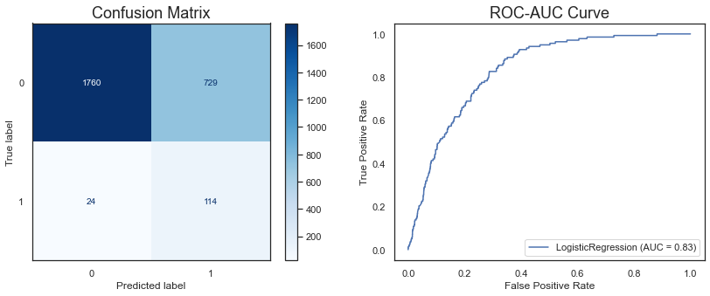
A closer look at the best performing model

Slide 21
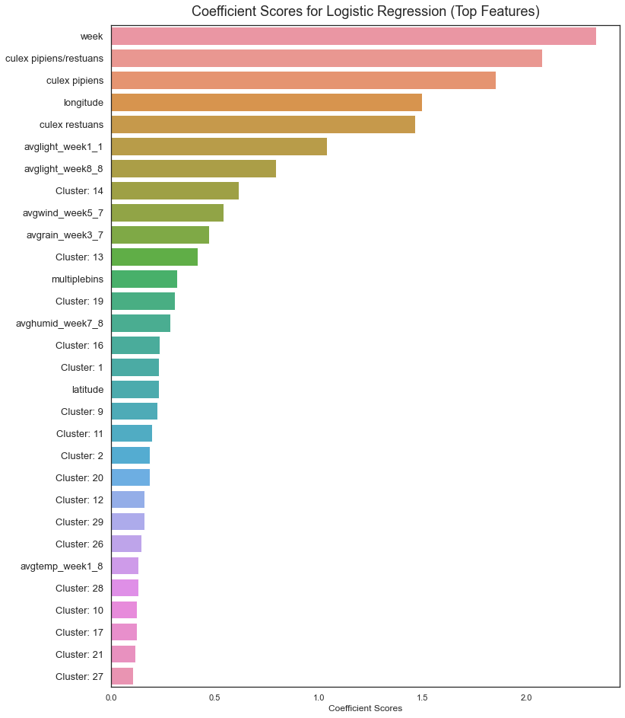
Best features
Week was a suitable proxy for season of the year
Day of the year and month of the year were also tested but did not improve the model
The presence of the 3 primary mosquito vectors strongly predicted the presence of WNV
Weather features were also effective in predicting WNV presence
Finally, geographical features such as cluster, latitude and longitude had the remaining explanatory power

Slide 22
Part IV
Key Findings & Recommendations

Slide 23



Key Findings
What best predicts the presence of the West Nile Virus?
Seasonality
Weather
Location
Our most predictive feature was the week of the year
As we saw from our EDA, the month of August and the weeks within it provide a timeframe where mosquitoes are most likely to carry the virus
Lagged and averaged weather data from different time periods in the past eight weeks proved to be predictive of the virus
Certain weather conditions in the past, including temperature, length of day and wind speed, affect the likelihood of whether the virus is present
Location features, including longitude and cluster categories, were also predictive
The mosquitos tend to breed in certain ‘hotspots’ over the years, which may be due to the physical conditions of the area or living habits of the population in that area.

Slide 24
Key Findings
Cost-Benefit Analysis of Spraying Insecticide
Cost:
It cost approximately USD$25,000 to spray an area of 28 squared km by Vector Disease Control International, the provider for Chicago this year.
Scaling appropriately, the cost would be about USD$540,000.
Benefit
1 in 5 people infected with WNV develop West Nile fever and 1 in 150 people develop more severe symptoms
In 2017, there were 90 WNV cases, including 8 deaths. Assuming the median household income in Chicago of $55,295 and an average hospital cost of USD$25,000 per patient, the cost was approximately USD$490,000.
Analysis
It will not be economic to conduct spraying insecticide, given the lack of impact.

Slide 25
Recommendations
What course of action should we take?
Insecticide spraying has not proven to be significant in reducing infection rates and requires more data and more campaigns for us to optimise its impact. In the meantime, we should also focus on other courses of action based on our findings.
Prepare ahead of time to combat the West Nile Virus during the period it is most likely to occur and invest more resources in:
Public information campaigns to prevent behaviour that would lead to mosquitos breeding
Increased testing, especially of traps that have a high prevalence of infection and traps that are close to previously infected traps
Focus on developing strategies specific to the two species Culex Pipiens and Culex Restuans e.g. releasing sterilised mosquitoes to breed with the mosquitos in the area.
Leverage a predictive model based on weather data and past data, to predict the most infectious periods and prepare for outbreaks

Slide 26
Part V
Conclusion

Slide 27
Conclusion
Key takeaways for this project
Project Limitations
We would have more insight into the course of action and performance of each model if we knew how our test data scores on different metrics: sensitivity, f1 score, accuracy etc., as currently, we are only able to score these by splitting our train data.
With more data on weather for the whole year, we would be able to better create our averaged weather metrics as well as see overarching trends for each year.
The setup of the dataset (samples split into bins of 50) is not conducive to creating a model that predicts for WNV at each location as the datasets should be grouped by samples taken.
Overall, our model helped us to find the most predictive features and we can continue to use it to help the city to identify potential outbreaks. It will need to be combined with vigilant monitoring on the ground, particularly during high risk periods.

Slide 28
Splitting of work
: Indicates ‘DONE’
Codes:
Notebook 1: Done
Notebook 2:
WT: Spray effectiveness
WT: Add clustering data
Notebook 3:
Alexis: Modelling
Presentation:
(% means the time allocated, also the amount of effort/slides you should put in)
Introduction/Business Problem: Alyse (10%)
Data Cleaning: (15%)
Train/Test: Alexis
Weather: Alexis
Spray: Alyse
EDA: (35%)
Train/Test: Alyse (Overall key findings)
Weather: Alexis (Correlation)
Spray: Alyse (Effectiveness)
Data Modelling: Dylan (25%)?
Key Findings/Recommendations: Dylan/Alexis (15%)
Conclusion: (Leave till the last)

